Slide 1
Measuring Room Occupancy:
Motion Detection in a Practical Setting
John Matsudaira & Mohamed Mostafa
Notes:
John

Slide 2
What Are We Trying To Do?
Detect when someone enters/exists a room
Track how many people are in the room at any given time
Notes:
John

Slide 3
Why Is This Important? What Are Applications?
Emergency Services
Event Planning
Building Security
Extensions Past People
(e.g. cars in a garage)
Notes:
Mo

Slide 4
Class Concepts Implemented
Edge Detection
Median Blur
Contour Detection
Thresholding
Grayscale Conversion
Notes:
Mo

Slide 5
How Do We Do This?
Physical Setup:
Install camera
Live stream onto laptop
Count the number of people entering and existing
Timestamp each occurrence
Code Overview:
Background Subtraction to detect motion
Contour Detection to identify people
Direction Calculations to determine entry or exit
Notes:
John

Slide 6
Background Subtraction
Create a priority queue to hold the last 5 frames
Create an average frame:
Avg Frame = (∑Frames in queue)/(num of frames)
Create Difference-of-Moving-Average (DoMA) image:
DoMA = current frame - Avg Frame
Resize image to lower run time
Blur to smooth the image, making edge and contour detection more accurate
Notes:
Mo

Slide 7
Background Subtraction DEMO:

Slide 8
2. Contour Detection
Median Blur to reduce noise
Apply Threshold
Detect Edges
Find Contours
Draw Contours
Notes:
John

Slide 9
Contour Detection DEMO:

Slide 10
3. Direction Determination
Once motion is identified:
Create moving average and store x coordinates of center point around biggest contour (identified by green box)
Compare last frame of movement to moving average
IF last frame x > moving average x —> Increase room count
IF last frame x < moving average x —> Decrease room count
Notes:
Mo

Slide 11
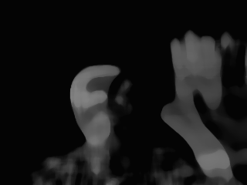
Direction Determination DEMO:

Slide 12
NEXT STEPS
Create more robust direction detection
Improve functionality with light refraction
Differentiate people within group
Increase efficiencies in runtime
Implement timestamp functionality
Notes:
John

Slide 13
THANK YOU!
Notes:
Both

